Slide 1
AWS Course Introduction

Slide 2

About Me
Developer, Team Lead
Many Java Project, 1-2 AWS projects
Accounts: Thomson Reuters, Syngenta
10 years in Development, Support and Customer Face fronts

Slide 3
Required Tools and Instruments
Skype Group: https://join.skype.com/I70BFD0KrhvC
GitRepo: https://github.com/rusergei2010/AWSCourse2019
Register in AWS to gain access to Console: https://aws.amazon.com/console/
Home Tasks
Practice 2-3 tasks
Theory - Quiz

Slide 4
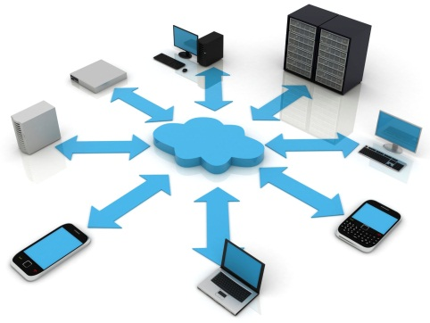



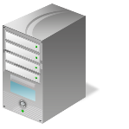
Cloud Computing Essentials
On-demand self-service
Broad network access
Resource pooling
Rapid elasticity
Measured service

Slide 5

Business Demand

Slide 6
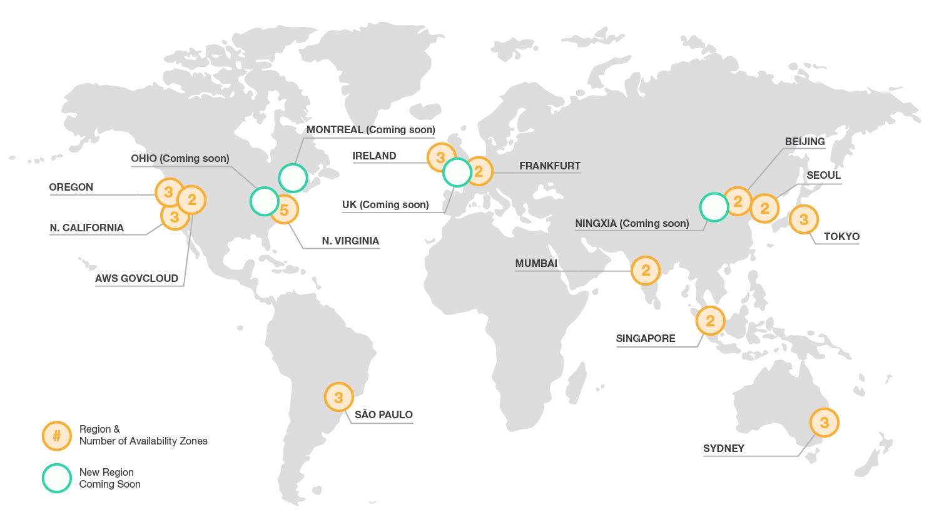
Global Infrastructure
https://aws.amazon.com/about-aws/global-infrastructure/

Slide 7
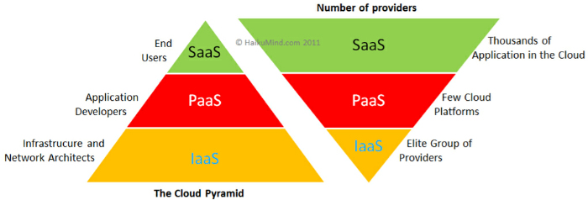
Cloud Computing types - SaaS (Office 365) - PaaS (OpenShift) - IaaS (AWS)

Slide 8
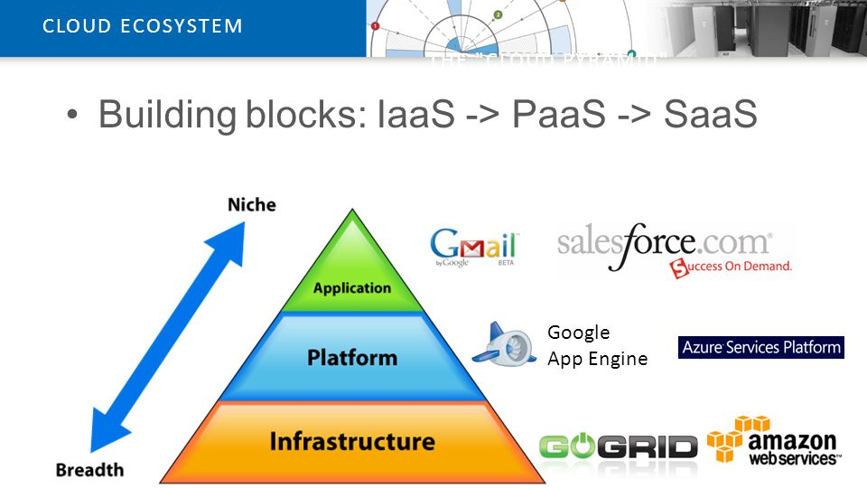
Vertical Structure of Cloud Computing platforms

Slide 9
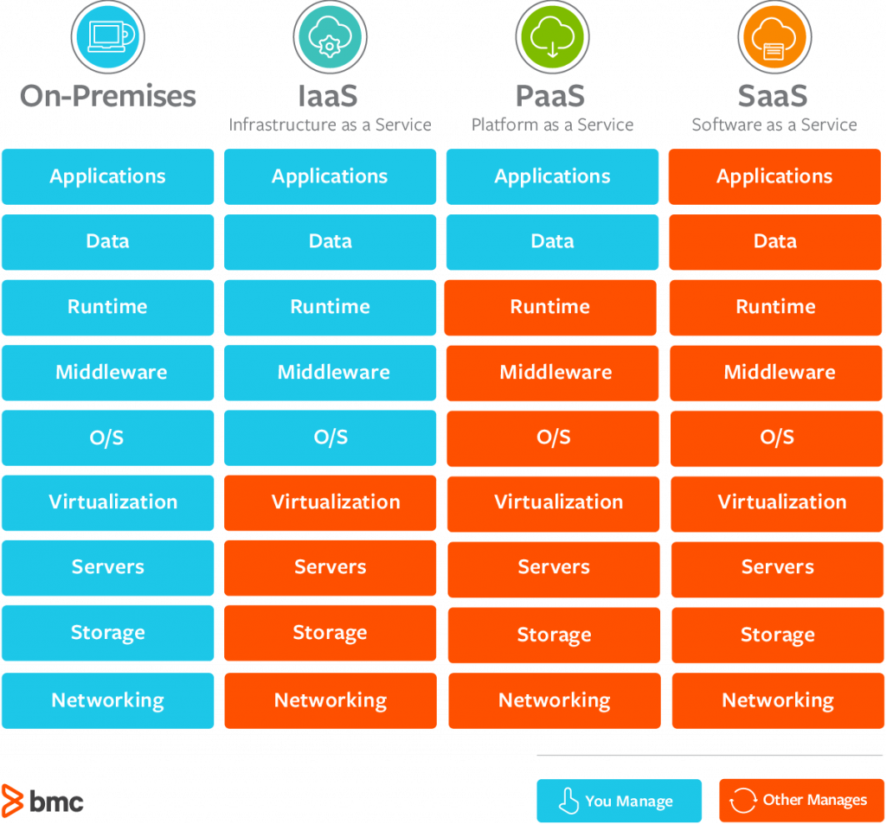
The Key Differences Between On-Premise, SaaS, PaaS, IaaS

Slide 10
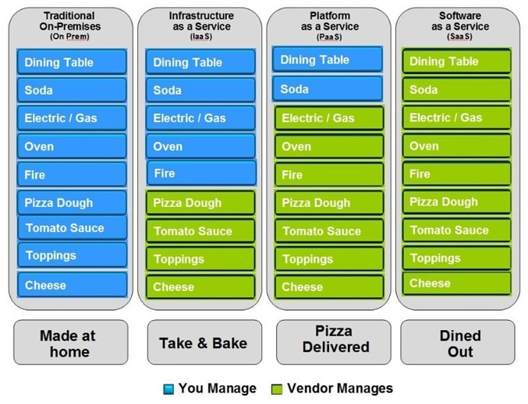
Pizza as a Service

Slide 11
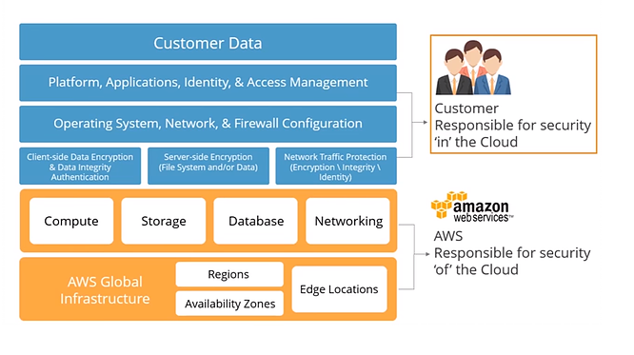
AWS shared responsibility model

Slide 12
Services to be discussed
EC2
Auto Scaling
CloudFormation
VPC
IAM (Identity and Access Management)
S3
DynamoDB
ElastiCache
RDS
CloudWatch Metrics, Logs
ECS
Lambda, API GW

Slide 13
Tools and languages will be used
AWS Web Console
AWS CLI - https://docs.aws.amazon.com/cli/latest/userguide/install-windows.html
AWS SDK
OpenShift
CloudFormation
Troposphere
Python

Slide 14
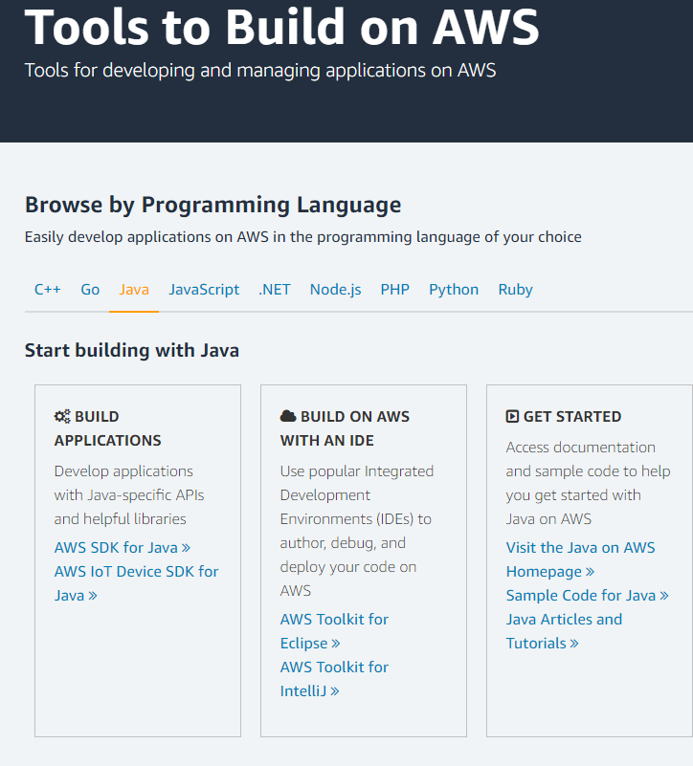
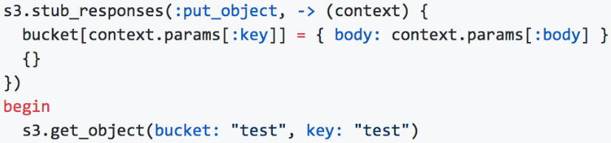
AWS SDK
https://aws.amazon.com/tools/

Slide 15
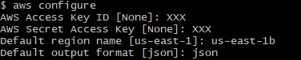
AWS CLI
AWS CLI https://docs.aws.amazon.com/cli/latest/userguide/install-windows.html
aws [options] <command> <subcommand> [parameters] Example:
$ aws s3 cp myvideo.mp4 s3://mybucket/
Credentials:
[default]
region = us-east-1
output = text
[profile epam_user]
region = us-east-1
output = json

Slide 16
Home Task
Join Skype Group: ‘AWS Course 2019’
Install AWS CLI
Register Free Tier Account in AWS

